Slide 1
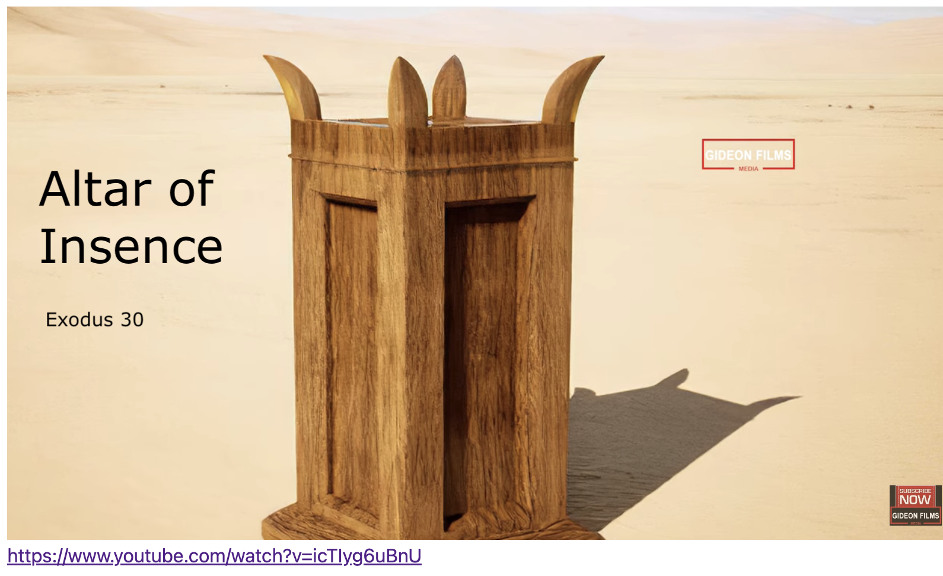
Exodus 出埃及記 30:11-16 The Altar of Incense
親子靈修 William分享
09-13-2025

Slide 2
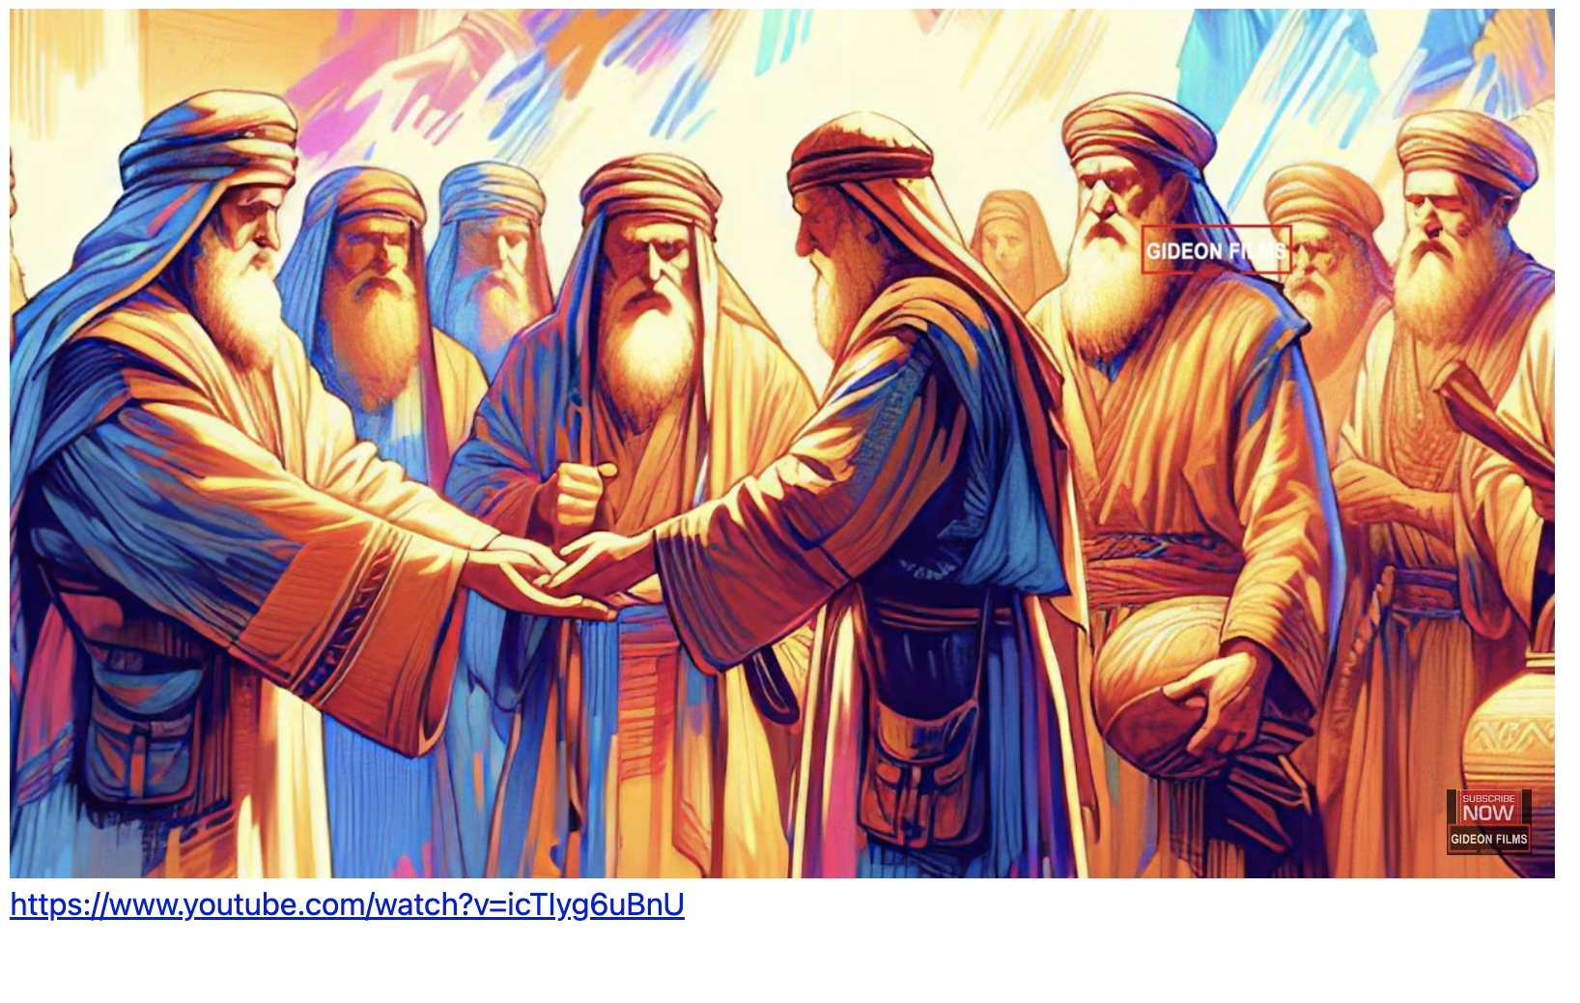
https://www.youtube.com/watch?v=icTIyg6uBnU English Version Video: Exodus 30:01-10.
(1 min)

Slide 3
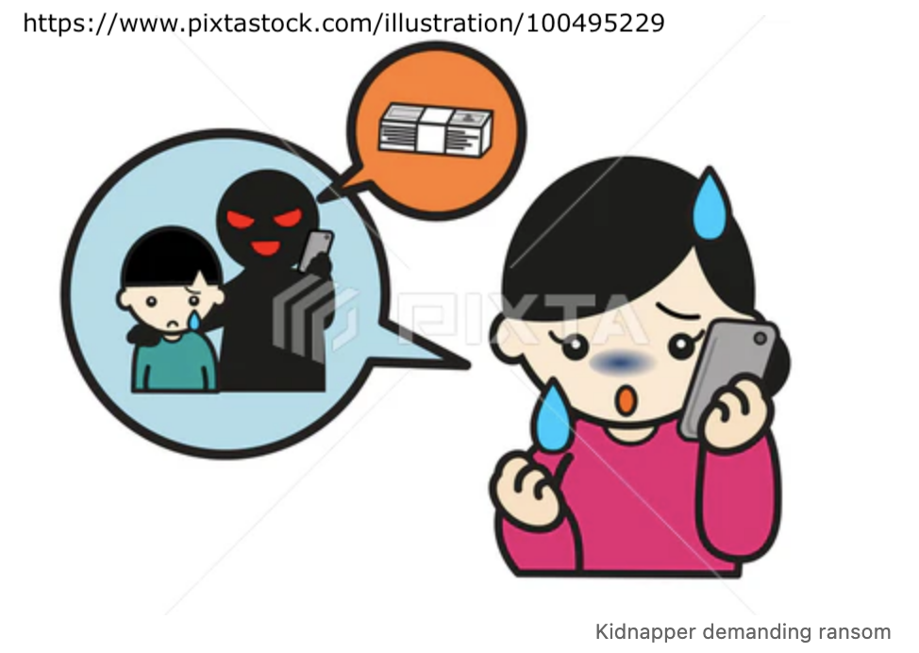
What is ransom (贖价/ 贖金)?
a sum of money or other payment demanded or paid for the release of a prisoner or person.

Slide 4
What is atone (贖回)?
Atone = at one
= make or become one united with God by paying a ransom.
= make amends or reparation of a broken relationship with God by paying a ransom.

Slide 5
Why ransom?
Apostle Paul said:
"因为世人都犯了罪、亏缺了 神的荣耀。" (Rom3:23 CUVS)
"for all have sinned and fall short of the glory of God," (Rom3:23 NIV)

Slide 6
Why atone?
Apostle Paul said:
"就如经上所记、『没有义人、连一个也没有．" (Rom3:10 CUVS)
"As it is written: "There is no one righteous, not even one;" (Rom3:10 NIV)

Slide 7
How can we restore relationship with God?
Apostle Paul said:
"神设立耶稣作挽回祭、是凭着耶稣的血、借着人的信、要显明 神的义．因为他用忍耐的心、宽容人先时所犯的罪．" (Rom3:25 CUVS)
"God presented him as a sacrifice of atonement, through faith in his blood. He did this to demonstrate his justice, because in his forbearance he had left the sins committed beforehand unpunished--" (Rom3:25 NIV)

Slide 8
How can we restore relationship with God?
Apostle Paul said:
"神使那无罪的、〔无罪原文作不知罪〕替我们成为罪．好叫我们在他里面成为 神的义。" (2Co5:21 CUVS)
"God made him who had no sin to be sin for us, so that in him we might become the righteousness of God." (2Co5:21 NIV)

Slide 9
個人反思 & 教養智慧
個人反思 Personal Reflection：
Can we atone for our relationship with God with our good deeds?
教養智慧：
"至于我、和我家、我们必定事奉耶和华。" (Jos24:15 CUVS)
"as for me and my household, we will serve the Lord ." (Jos24:15 NIV)

Slide 10
Closing Prayer
Dear Heavenly Father, the Glorious Lord, the Creator, and Sovereign of all things. Thank you for your mercy and grace. Thank you for calling us, the parents. Thank you for giving us, the parents, the educational authority. Our children are your heritage. We are the sinners; we do not deserve it. May Your Holy Spirit call us, guide us. Bless our children and young generation to be able to know you, follow you to be the devotional generation. May your name be glorified, generation by generation, and forever. I pray in the name of Jesus. Amen.

Slide 11
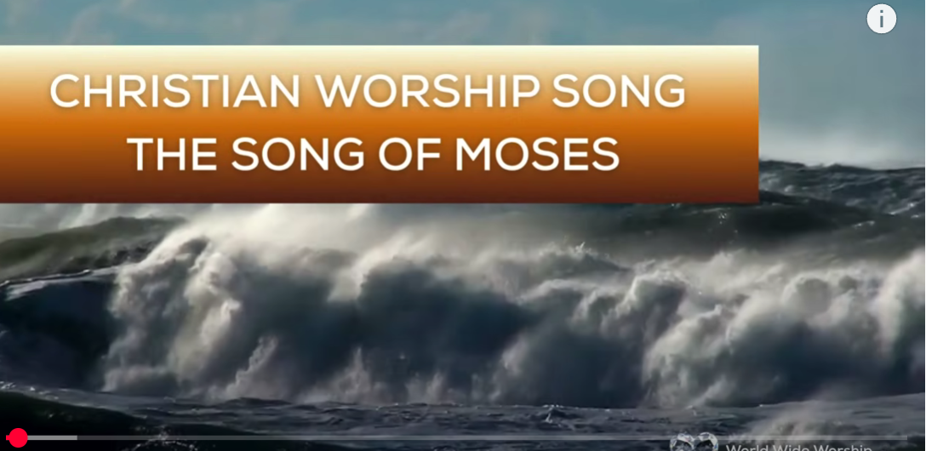
1.No Turning Back
https://www.youtube.com/watch?v=yNtid3wdDWA&list=RDyNtid3wdDWA&start_radio=1&ab_channel=GaiseBaba
Christian Kids
https://www.youtube.com/watch?v=7vihn5MpWSc&list=RD7vihn5MpWSc&start_radio=1
2. The Song of Moses https://www.youtube.com/watch?v=a-wWKL-7Mrg
The Song of Moses Like You've Never Heard Before | Christian Worship Song/ World Wide Worship

